Slide 1
Predict a policy type and price for a customer based on browsing and transaction history INFO 7309 Machine Learning for Business Intelligence
Data Wizards
Leela Gangadhar Vallabhaneni
Nuhiya Rafeeq
Sumit Deshmukh

Slide 2
Approach
Step 1:
Predict the Policy Number.
Step 2:
Predict the Cost of the Policy.

Slide 3
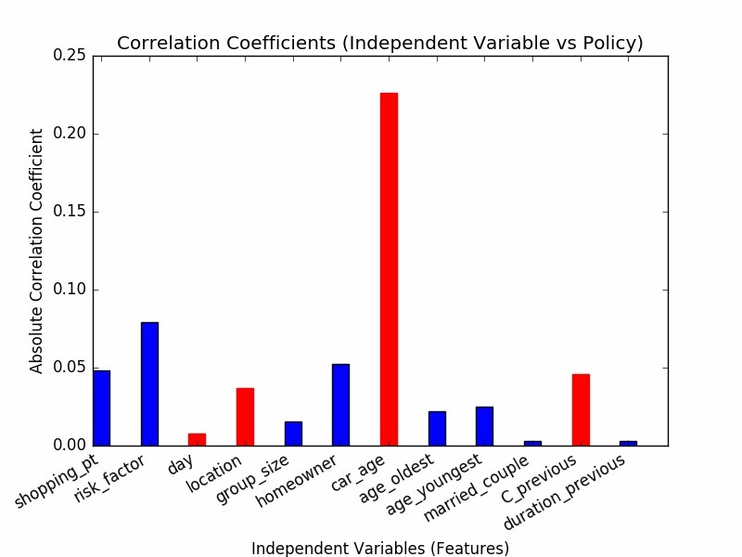
Initial Findings
~30% instances with NA values
Normalization (one-hot encoding)
Feature Selection with best
Correlation Co-efficient
Imbalanced Classes

Slide 4
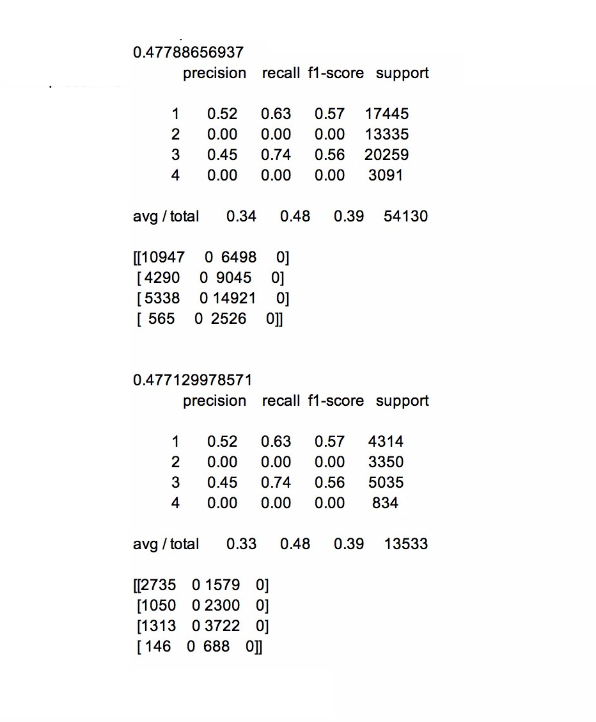
Step 1: Model-1
Train Data (80%)
Accuracy 0.477
Precision 0.34
Recall 0.48
Test Data (20%)
Accuracy 0.477
Precision 0.33
Recall 0.48
Findings: Poorly Performing.
Never predicts Policy No.4 correctly

Slide 5
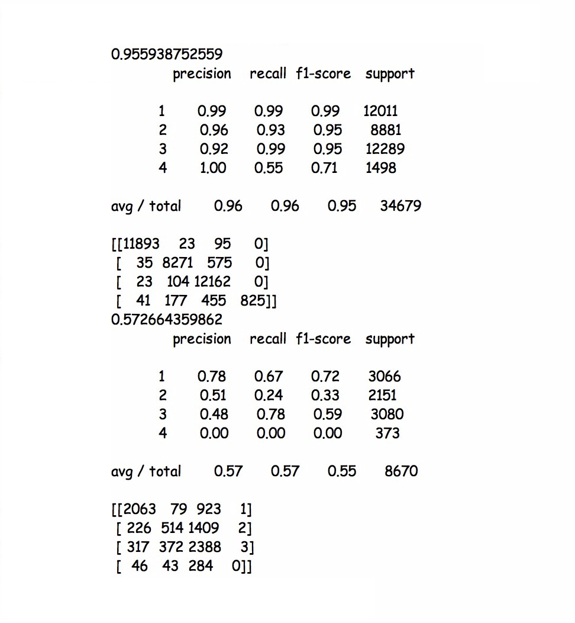
Step 1: Model-2
Train Data (80%)
Accuracy 0.955
Precision 0.97
Recall 0.96
Test Data (20%)
Accuracy 0.57
Precision 0.58
Recall 0.55
Findings: Over Fitting Training Data
Never predicts Policy No.4 correctly

Slide 6
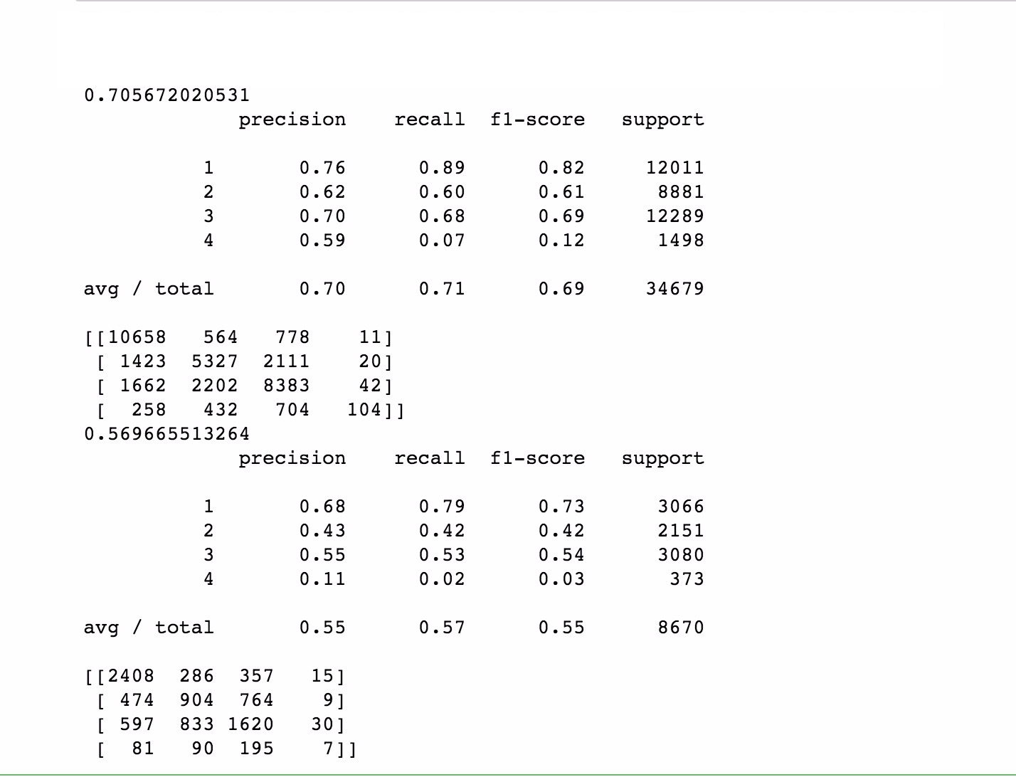
Step 1: Model-3
Train Data (80%)
Accuracy 0.70
Precision 0.7
Recall 0.71
Test Data (20%)
Accuracy 0.56
Precision 0.55
Recall 0.57
Findings: Better Model

Slide 7
Findings
Smaller class being treated as an outlier and the model learns the decision boundary for only the larger class.
Over-sampling or under-sampling techniques should be applied.

Slide 8
What Next?
Improve the existing Models using suitable techniques.
Use the Best Model to predict Policy Price using Regression Algorithms.

